Slide 1

Box Model in CSS

Slide 2
Box Model
CSS box model is a container which contains multiple properties including borders, margin, padding and the content .
It is used to create the design and layout of web pages.
It can be used as a toolkit for customizing the layout of different elements.
The web browser renders every element as a rectangular box according to the CSS box model.

Slide 3
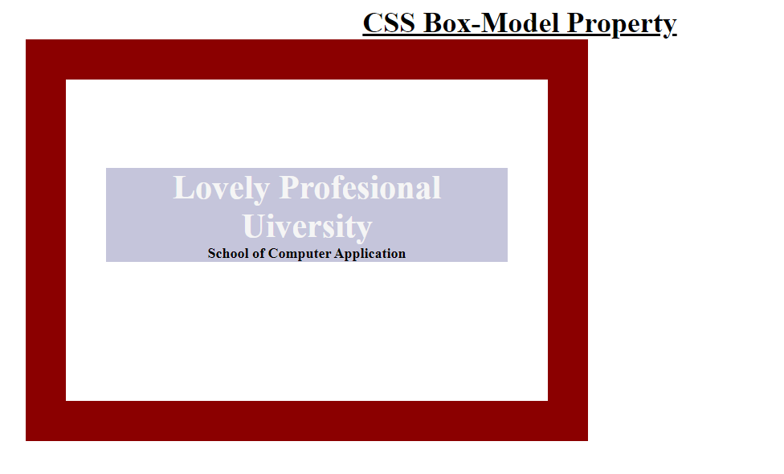
Box-Model properties in CSS
Border
Margins
Padding
Content

Slide 4
CSS outline
CSS outline property allows us to draw a line around the element, outside the border.
CSS has following outline properties:
1.Outline-style 2.Outline-color 3.Outline-width 4.Outline-offset

Slide 5
Outline Style
Types of outline-style: 1.Dotted 2.Dashed 3.Solid 4.Double 5.Groove 6.Ridge 7.Inset 8.Outset

Slide 6
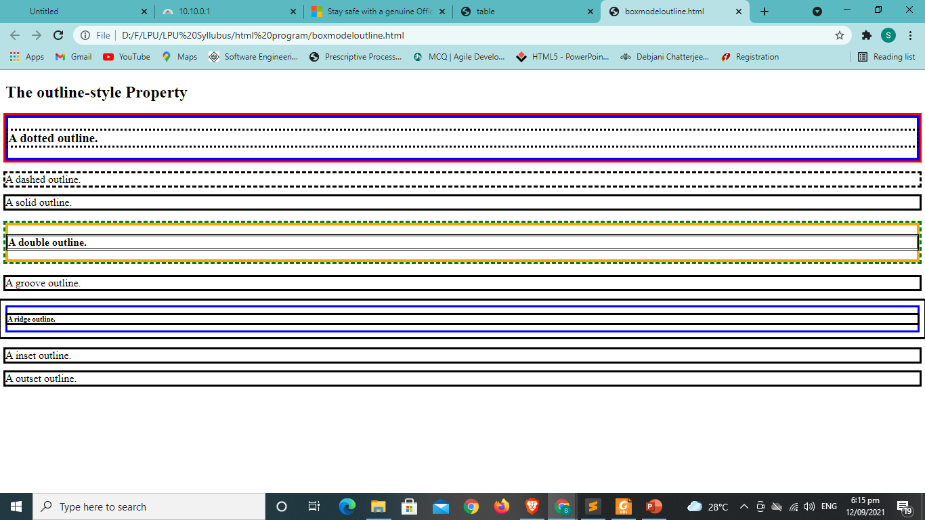
The outline-style Property

Slide 7
Question
Which part of box model clears an area around the content?
Padding B. Border
C. Margin D. None of the above

Slide 8
Question
When you set the width and height properties of an element with CSS, you just set the width and height of the?
Padding B. Margin
C. Content D. border

Slide 9
CSS Position
The position CSS property sets how an element is positioned in a document. The top, right, bottom, and left properties determine the final location of positioned elements.
Syntax
position: static; (top,right, bottom,left, z-index)
position: relative; (top,right, bottom,left, static)
position: absolute; (top,right, bottom, and left)
position: fixed; (top,right, bottom,left, z-index)
position: sticky;(top,right, bottom,left, z-index)
/* Global values */
position: inherit;
position: initial;
position: revert;
position: unset;

Slide 10
Types of positioning
Positioned element
Relatively positioned element
Absolutely positioned element
Stickily positioned element

Slide 11
Question
How many types of position values are there in CSS?
2 B. 3
C. 4 D. 5

Slide 12
Question
The default for any page element is?
Fixed B. relative
C. absolute D. Static

Slide 13
Question
Positioning attributes top, bottom, left and right are used to determine the exact location
TRUE B. FALSE
C. Can be true or false D. Can not say

Slide 14
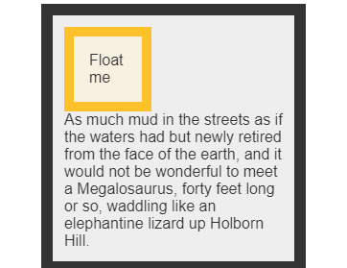
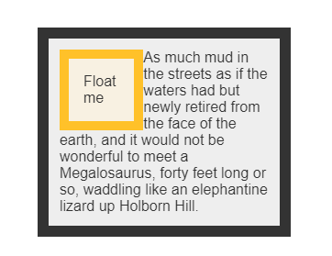
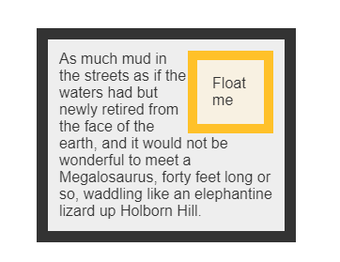
CSS float
The float CSS property places an element on the left or right side of its container, allowing text and inline elements to wrap around it.
The element is removed from the normal flow of the page
Example: float: none; float:left; float:right

Slide 15
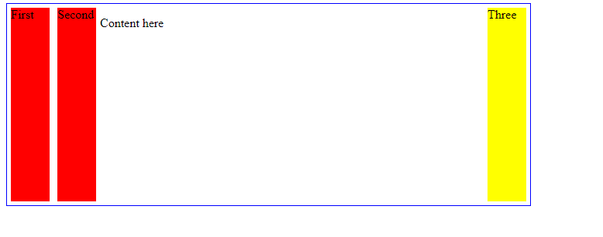
Example

Slide 16
Question
Which of the following values are accepted by the float Property?
a) left b) right
c) none d) all of the mentioned

Slide 17
Question
The default value for the float property is right. State true or false.
a) True b) False

Slide 18
Display property
The Display property in CSS defines how the components(div, hyperlink, heading, etc) are going to be placed on the web page.
As the name suggests, this property is used to define the display of the different parts of a web page.
Syntax: display:value;
Property values (inline, block, contents, grid, inline-block, inline-flex, flex, inline-grid, list-item, inline-table, group, table-header, table-footer, table-cell, table-column, table-row, none, initial)

Slide 19
Syntax
Display:block; inline; inline-block;flex;inline-flex;grid;inline-grid;flow-root;
Box generation(none; contents)
Two-values syntax(block flow, inline flow;inline flow-root, block flex; inline flex, block grid, inline grid, block flow root)
Other values( table, table-row, list-item)
Global values(inherit, initial, revert, unset)

Slide 20
Question
Which of the following elements are block and inline elements, respectively, that have no particular rendering?
A div B span
C box-model D both(A) and (B)

Slide 21
Question
The_____ property specifies the background color of an element
A background-color B border
C color D display

Slide 22
Media queries
Media queries are for different style rules for different size devices such as mobiles, desktops, etc.
Understanding CSS Media Types and Queries
CSS Media Types and Queries help the user to define certain styles in accordance with a device’s general type (screen, print, etc.) or its characteristics (screen resolution, viewport dimensions, etc.)
Syntax
@media not | only mediatype and (expressions) {
CSS-Code;
}

Slide 23
Example
<link rel="stylesheet" media="print and|not|only (expressions)" href="print.css">
<link rel="stylesheet" media="screen and|not|only (expressions)" href="screen.css">
Media types values (all, print, screen, speech)

Slide 24
Question
Which of the following media feature describes the number of entries in the color lookup table of the output device
a) color b) color-index
c) color-value d) color-@media

Slide 25
Question
Which of the following Viewport Property sets the initial scaling factor?
a) scale b) initial-scale
c) minimum-scale d) user-scale

Slide 26
Question
Which of the following @viewport Property sets the viewport height in the same way as width?
a) height b) width
c) viewpor-width d) none of the mentioned

Slide 27
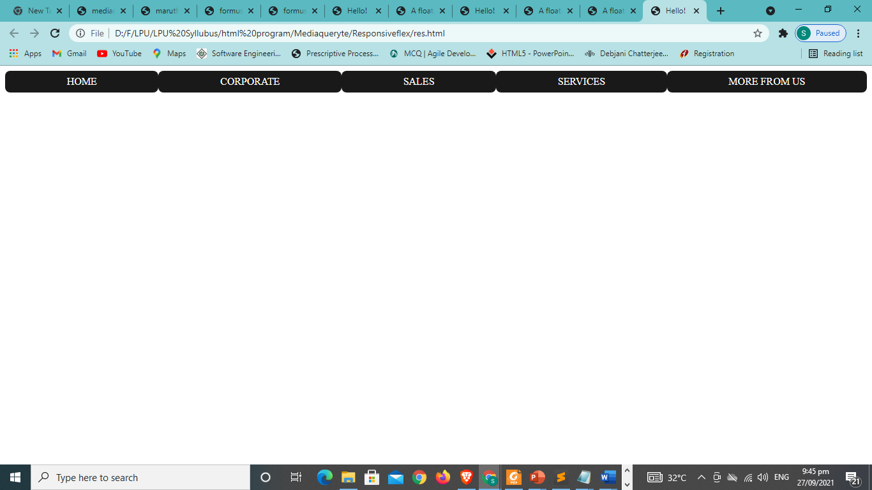
What will be the program code for this.

Slide 28
Flexbox
CSS3 provides another layout mode Flexible Box, commonly called as Flexbox.
Easily create layouts for complex applications and web pages. Unlike floats, Flexbox layout gives complete control over the direction, alignment, order, size of the boxes.
Features of Flexbox
Direction
Order
Wrap
Alignment
Resize

Slide 29
Flexbox - Flex Containers
To create/define a flex container using the display property.
Usage −
dis[play: flex | inline-flex

Slide 30
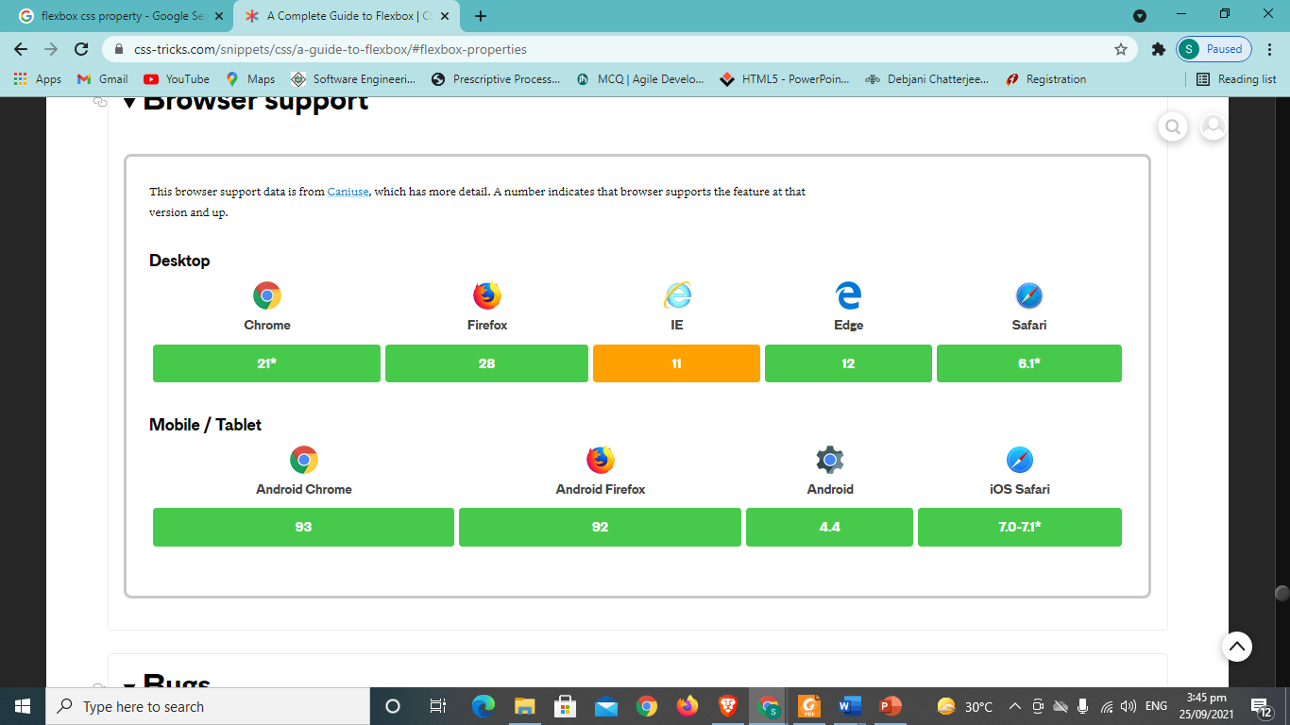
Browser support

Slide 31
Grid
To design a web page, you can also follow the Grid Layout Module, i.e. a grid with rows and columns.
Grid Layout has grid elements, rows, columns, gaps, etc.
Grid Layout has parent and child elements.
Rows are the horizontal line of grid items, however, Columns are the vertical line.
Using grid you specify one axis using grid-template-rows or grid-template-columns.
Then specify how content should auto-repeat in the other axis using the implicit grid properties: grid-auto-rows, grid-auto-columns, and grid-auto-flow.

Slide 32
Example
Make a three columns grid layout where the first row is 150px high:
.grid-container { display: grid; grid: 150px / auto auto auto; }

Slide 33
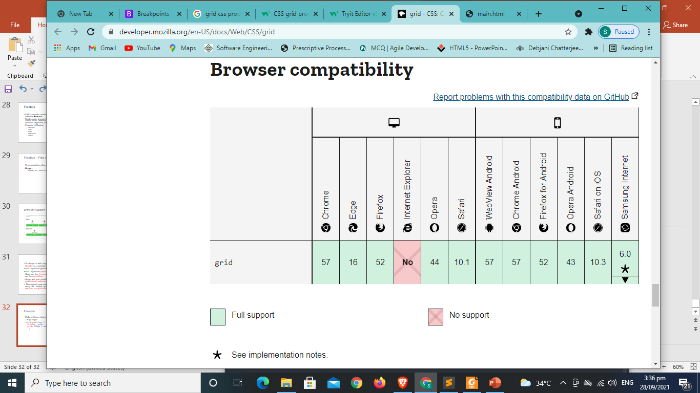
Browser compatibility

Slide 34
The Grid Property
Grid-template-rows
Grid-template-columns
Grid-template-areas
Grid-auto-rows
Grid-auto-columns
Grid-auto-flow

Slide 35
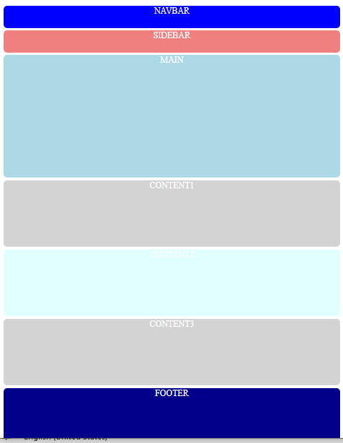
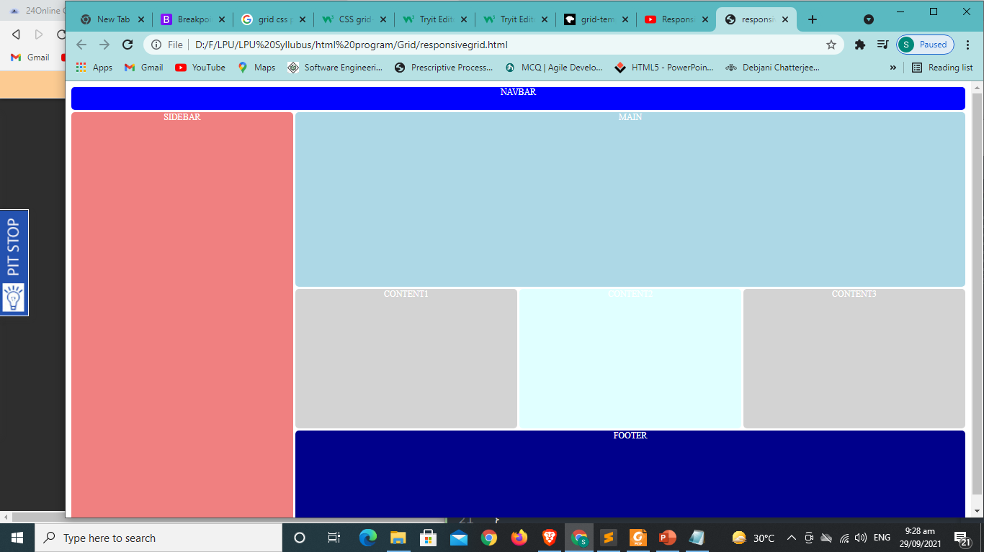
Grid CSS demonstration

